Slide 1
Team Performance

Slide 2
Leaders Are Always Being Watched
Your team will watch how you behave and mimic your behaviour.
If it ok for you it ok for them.
Notes:
Lombardi

Slide 3
Getting Things Done
Your teammates will see you putting in more work than everyone else, every day, every week, this will motivate them to put in the extra time that will make the difference.
No Excuses
You need to work if there is worked to be done.
Notes:
Lombardi

Slide 4
Study the Past but Live in the Present
Each task is new and independent challenge
Give credit where credit is due.
Ego has to be defeated in self
Notes:
Lombardi

Slide 5
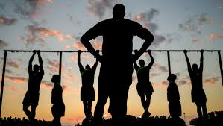
How to Lead Others
What is expected and why
Paint a picture of what their job would look like if performed excellently
Provide all the tools needed to succeed
Notes:
Lombardi

Slide 6
Creating Good Habits
Discipline through repetition
Leaders are in the belief business
Leadership is demonstrated on a daily basis, not some days but everyday
Notes:
Lombardi

Slide 7


The Winning Habit
Slap on the back
Respect and compassion for others
Always seek the truth, and is the foundation for character
Without trust you can 't lead people
Notes:
Lombardi

Slide 8
End Team Performance

